Slide 1


Methods

Slide 2
So Many Boxes
int life = 42;
double d = 14.0 / 2.5;
String s = "This is a string";
GRect rect = new GRect(width, height);
GRect rect = new GRect(x, y);
We can create many types of variables in Java!!

Slide 3
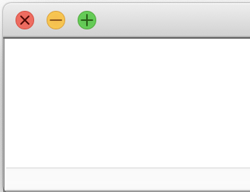
Updating Variables
Console Programs
int life = 42;
life = 42 – life;
life = 15;
life = life / 2; println(life * 3);
life
21
7
15
42
0
Graphics Programs
GRect rectR = new GRect(100, 100);
rectR.setColor(Color.RED);
GRect rectB = new GRect(100, 100);
rectB.setColor(Color.BLUE);
rectB = rectR;
add(rectB, 0, 0);
rect1
rect2

Slide 4
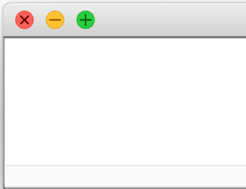
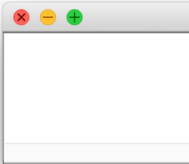


Animation loop
int count = 0;
GLabel countDisplay = new GLabel("" + count);
add(countDisplay, 1,50);
while(true) {
// updates text of label
countDisplay.setLabel("" + count);
count += 1;
/* What happens when we insert * the code from cases 1, 2, and 3? */
}
(1) if (count > 10) { break;
}
(2) // nothing
(3) pause(500);
🤔

Slide 5
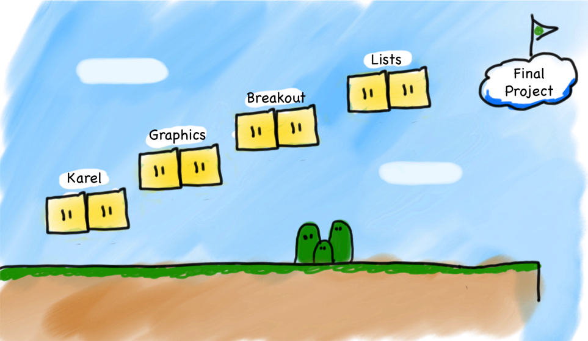
Our Second Step
Methods
Notes:
Let's just jump straight into it!

Slide 6


Today’s Goals
What is a method and how do we talk about it?
How do we define our own methods?
What is happening when we call a method?

Slide 7
Calling Methods
Methods
turnRight();
move();
readInt(“Int please! ”);
println(“hello world”);
rect.getX();
drawRobotFace();
rect.setLocation(10, 20);
Today, we will learn exactly what these methods are doing!

Slide 8

Defining a Method
High schooler Karel living in 2019
private void turnRight() {
turnLeft();
turnLeft();
turnLeft();
}
It’s been a minute!
(translation: Long time no see!)

Slide 9
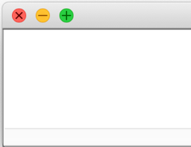

Defining a Method
public void run() {
printAverage1();
printAverage2();
}
private void printAverage1() {
double a = 5.0;
double b = 10.2;
double sum = a + b;
double mid = sum / 2;
println(mid);
}
private void printAverage2() {
double a = 6; // int 6 → double 12.0
double b = 18.0;
double sum = a + b;
double mid = sum / 2;
println(mid);
}
7.6
12.0
But wait…I thought methods help reuse code!
🤔

Slide 10
Ovens are Methods
Java methods can take in data and return other data!!
parameter
bakeInOven
return value

Slide 11
Ovens are Methods
Java methods can take in data and return other data!!
You don’t need a different oven for lahmacun. Use the same one.
bakeInOven
parameter
return value

Slide 12
Ovens are Methods
Java methods can take in data and return other data!!
bakeInOven
parameter
return value
You don’t need a different oven for lahmacun. Use the same one.

Slide 13
Ovens are Methods
Java methods can take in data and return other data!!
bakeInOven
parameter
return value
Not all inputs work.

Slide 14
The Java method
public void run() {
double mid1 = average(5.0, 10.2);
println(mid1);
double mid2 = average(6, 18);
println(mid2);
}
private double average(double a, double b) {
double sum = a + b;
return sum / 2;
}
method “call”
method name
7.6
12.0
method definition
average(double a, double b) is a method that:
Takes as input two doubles (a and b).
Outputs a double
Averages the two inputs.
We will get here step by step!!
Notes:
We will get here step by step!

Slide 15
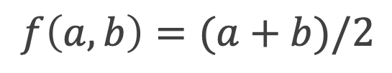
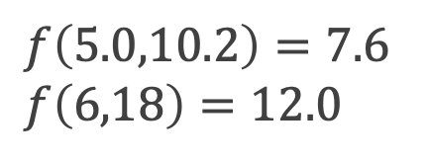
The Algebra Version
public void run() {
double mid1 = average(5.0, 10.2);
println(mid1);
double mid2 = average(6, 18);
println(mid2);
}
private double average(double a, double b) {
double sum = a + b;
return sum / 2;
}
7.6
12.0
Method definition:
Method calls:
$$f\left(a,b\right)=(a+b)/2$$
$f\left(5.0,10.2\right)=7.6$
$f\left(6,18\right)=12.0$

Slide 16
The Java method
public void run() {
double mid1 = average(5.0, 10.2);
println(mid1);
double mid2 = average(6, 18);
println(mid2);
}
private double average(double a, double b) {
double sum = a + b;
return sum / 2;
}
Return type
Parameters
7.6
12.0

Slide 17
Anatomy of a method
public void run() {
double mid1 = average(5.0, 10.2);
println(mid1);
double mid2 = average(6, 18);
println(mid2);
}
private double average(double a, double b) {
double sum = a + b;
return sum / 2;
}
7.6
12.0
method body
return value

Slide 18
Calling and Defining Methods
arguments
public void run() {
double mid1 = average(5.0, 10.2);
println(mid1);
double mid2 = average(6, 18);
println(mid2);
}
private double average(double a, double b) {
double sum = a + b;
return sum / 2;
}
method “call”
parameters
7.6
12.0
method definition
arguments: calling and executing method
vs
parameters: defining method input

Slide 19
Explaining the void and the ()
public void run() {
printIntro();
}
private void printIntro( ) {
println("Welcome to class");
println("It's the best part of my day.");
// nothing here
}
return type
name
parameters
⚠️ void methods don’t need a return.
printIntro() is a method that:
Takes no parameters.
Returns nothing.
It just always prints:
Welcome to class
It's the best part of my day.

Slide 20
Methods Dear to Our Heart
Parameter
Types?
Return
Types?
Method name
average(5.0, 10.2);
double,double
double
printIntro();
(nothing)
(nothing)
turnRight();
(nothing)
void
readInt("Enter age: ");
String
int
println(”You’re cool!");
String
void
getWidth();
(nothing)
double
rect.setLocation(10,20);
double,double
void
🤔

Slide 21

Questions?
TL;DR: (too long; don’t read)
(the summary)
bakeInOven
parameter
return value

Slide 22
Today’s Goals
✓
What is a method and how do we talk about it?
How do we define our own methods?
What is happening when we call a method?

Slide 23
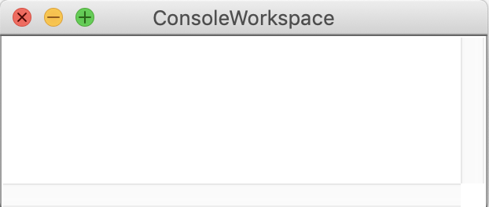
Parameter Example
public void run() {
printOpinion(5);
}
private void printOpinion(int num) {
if(num == 5) {
println("I love 5!");
} else {
println("Whatever");
}
}
I love 5!
???
Notes:
Let’s understand how to read methods.

Slide 24
Multiple Return
private String getMonthName(int index) {
if (index == 0) {
return "January";
}
if (index == 1) {
return "February";
}
...
return "Unknown";
}

Slide 25
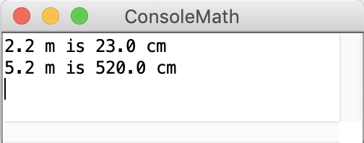
Parameter + Returns
public void run() {
double conversion = metersToCm(2.2);
println("2.2 m is " + conversion + " cm");
println("5.2 m is " + metersToCm(5.2) + " cm");
}
private ??????? metersToCm(???????) {
/* Fill this in too */
}
Step (1)
Step (2)
Let’s program together!
Notes:
Go straight to programming

Slide 26
Parameter + Returns
public void run() {
double conversion = metersToCm(2.2);
println("2.2 m is " + conversion + " cm");
println("5.2 m is " + metersToCm(5.2) + " cm");
}
private double metersToCm(double meters) {
return meters * 100;
}
⚠️ You must name your input variables!
Let’s program together!

Slide 27
Parameter + Returns
public void run() {
double conversion = metersToCm(2.2);
println("2.2 m is " + conversion + " cm");
println("5.2 m is " + metersToCm(5.2) + " cm");
}
private double metersToCm(double meters) {
return meters*100;
}
⚠️ Any non-void method must return something!
Let’s program together!

Slide 28
Summary: Defining a Method
visibility type nameOfMethod(parameter types and names) {
statements
}
visibility: usually private or public
type: type returned by method
int , double , etc. must include a double value!
Can be void to indicate that nothing is returned
Input parameters: information passed into method

Slide 29
Today’s Goals
✓
What is a method and how do we talk about it?
How do we define our own methods?
What is happening when we call a method?
✓

Slide 30

Java Execution of Methods
“equals”
Evaluate right hand side
Store result in variable on left hand side
=

Slide 31
public void run() {
GLabel redLabel = coloredLabel("Red label", Color.RED);
add(redLabel, 50, 50);
GLabel label = coloredLabel(”Blue label", Color.BLUE);
add(label, 100, 100);
}
private GLabel coloredLabel(String text, Color fill) {
GLabel label = new GLabel(text);
label.setFont("Calibri-50");
label.setColor(fill);
return label;
}
How does this program execute?

Slide 32

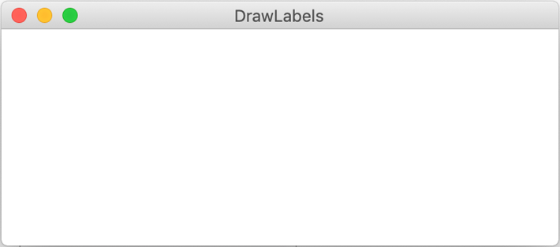
public void run() {
GLabel redLabel = coloredLabel("Red label", Color.RED);
add(redLabel, 50, 50);
GLabel label = coloredLabel(”Blue label", Color.BLUE);
add(label, 100, 100);
}
“equals”
Evaluate right hand side
Store result in variable on left hand side
=

Slide 33
public void run() {
GLabel redLabel = coloredLabel("Red label", Color.RED);
add(redLabel, 50, 50);
GLabel label = coloredLabel(”Blue label", Color.BLUE);
add(label, 100, 100);
}
private GLabel coloredLabel(String text, Color fill) {
GLabel label = new GLabel(text);
label.setFont("Calibri-50");
label.setColor(fill);
return label;
}
text
"Red label"
fill
Color.RED
“equals”
Evaluate right hand side
Store result in variable on left hand side
=

Slide 34
public void run() {
GLabel redLabel = coloredLabel("Red label", Color.RED);
add(redLabel, 50, 50);
GLabel label = coloredLabel(”Blue label", Color.BLUE);
add(label, 100, 100);
}
private GLabel coloredLabel(String text, Color fill) {
GLabel label = new GLabel(text);
label.setFont("Calibri-50");
label.setColor(fill);
return label;
}
text
"Red label"
fill
Color.RED
label
Red label
Red label
Red label

Slide 35
public void run() {
GLabel redLabel = coloredLabel("Red label", Color.RED);
add(redLabel, 50, 50);
GLabel label = coloredLabel(”Blue label", Color.BLUE);
add(label, 100, 100);
}
private GLabel coloredLabel(String text, Color fill) {
GLabel label = new GLabel(text);
label.setFont("Calibri-50");
label.setColor(fill);
return label;
}
text
"Red label"
fill
Color.RED
label
Red label

Slide 36
public void run() {
GLabel redLabel = coloredLabel("Red label", Color.RED);
add(redLabel, 50, 50);
GLabel label = coloredLabel(”Blue label", Color.BLUE);
add(label, 100, 100);
}
Red label
Red label
redLabel
Red label

Slide 37
public void run() {
GLabel redLabel = coloredLabel("Red label", Color.RED);
add(redLabel, 50, 50);
GLabel label = coloredLabel(”Blue label", Color.BLUE);
add(label, 100, 100);
}
Red label
redLabel
Red label

Slide 38
public void run() {
GLabel redLabel = coloredLabel("Red label", Color.RED);
add(redLabel, 50, 50);
GLabel label = coloredLabel(”Blue label", Color.BLUE);
add(label, 100, 100);
}
private GLabel coloredLabel(String text, Color fill) {
GLabel label = new GLabel(text);
label.setFont("Calibri-50");
label.setColor(fill);
return label;
}
text
”Blue label"
fill
Color.BLUE
Red label
redLabel
Red label

Slide 39
public void run() {
GLabel redLabel = coloredLabel("Red label", Color.RED);
add(redLabel, 50, 50);
GLabel label = coloredLabel(”Blue label", Color.BLUE);
add(label, 100, 100);
}
private GLabel coloredLabel(String text, Color fill) {
GLabel label = new GLabel(text);
label.setFont("Calibri-50");
label.setColor(fill);
return label;
}
text
”Blue label"
fill
Color.BLUE
label
label
Red label
label
label
redLabel
Red label

Slide 40
public void run() {
GLabel redLabel = coloredLabel("Red label", Color.RED);
add(redLabel, 50, 50);
GLabel label = coloredLabel(”Blue label", Color.BLUE);
add(label, 100, 100);
}
private GLabel coloredLabel(String text, Color fill) {
GLabel label = new GLabel(text);
label.setFont("Calibri-50");
label.setColor(fill);
return label;
}
text
”Blue label"
fill
Color.BLUE
label
Red label
label
redLabel
Red label

Slide 41
public void run() {
GLabel redLabel = coloredLabel("Red label", Color.RED);
add(redLabel, 50, 50);
GLabel label = coloredLabel(”Blue label", Color.BLUE);
add(label, 100, 100);
}
label
label
Red label
label
label
redLabel
Red label

Slide 42
Questions?

Slide 43
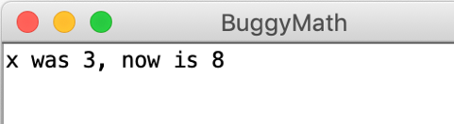
Bad Times With Methods
⚠️
public void run() {
int x = 3;
int prevX = x;
addFive(x);
println("x was " + prevX + ", now" + x);
}
private void addFive(int x) {
x += 5;
println(x);
}
(intention)
⚠️
⚠️
🤔
There are three bugs in this program!

Slide 44
Good Times With Methods
public void run() {
int x = 3;
int prevX = x;
x = addFive(x);
println("x was " + prevX + ", now" + x);
}
private int addFive(int x) {
x += 5;
return x;
}
That’s more like it!

Slide 45
More Examples

Slide 46
Changed Name
private void run() {
int num = 5;
cow(num);
}
private void cow(int grass) {
println(grass);
}
🤔

Slide 47
Changed Name
private void run() {
int num = 5;
cow(num);
}
num
5
private void cow(int grass) {
println(grass);
}
🤔

Slide 48
Changed Name
private void run() {
int num = 5;
cow(num);
}
5
num
5
private void cow(int grass) {
println(grass);
}
grass
5
5

Slide 49
Same Variable
private void run() {
int num = 5;
cat();
}
private void cat() {
int num = 10;
println(num);
}

Slide 50
Same Variable
private void run() {
int num = 5;
cat();
}
num
5
private void cat() {
int num = 10;
println(num);
}

Slide 51
Same Variable
private void run() {
int num = 5;
cat();
}
num
5
private void cat() {
int num = 10;
println(num);
}
num
10
10

Slide 52
Today’s Goals
✓
What is a method and how do we talk about it?
How do we define our own methods?
What is happening when we call a method?
✓
✓

Slide 53
Today’s material is difficult.
👍 Good job surviving 👍
🙋‍♂️Bring your questions to section!🙋‍♀️
Mad Methods

Slide 54

Boolean

Slide 55
Boolean Variable
boolean karelIsAwesome = true;
boolean myBool = 1 < 2;

Slide 56
Boolean Operations
boolean a = true;
boolean b = false;
//This is false
boolean a_and_b = a && b;
//This is true
boolean a_or_b = a || b;
// This is false
boolean not_a = !a;

Slide 57

Now that’s style!

